Slide 1
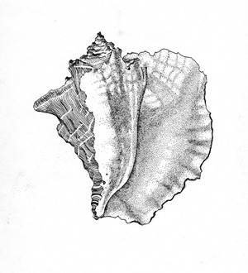
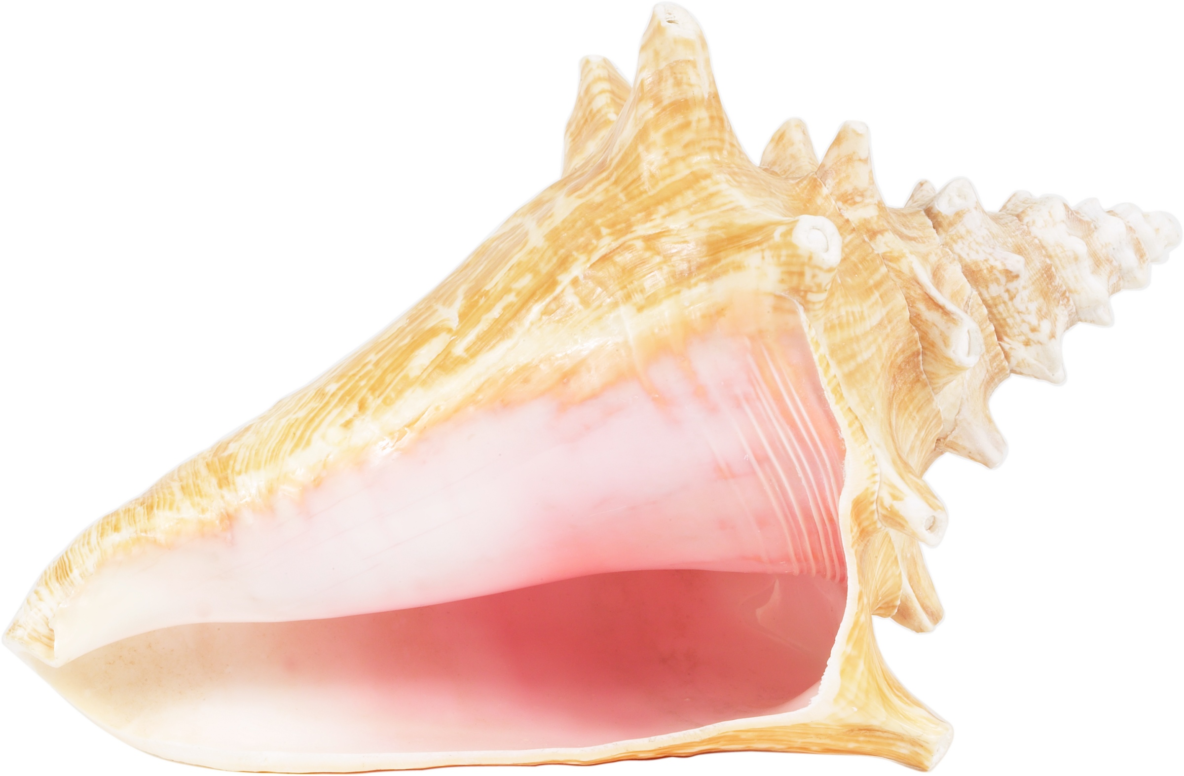
The Conch Symbolism
Carson, Ella, Kayla, and Ian

Slide 2
The Conch Shell’s Timeline
Piggy and Ralph find the conch

Slide 3
Piggy and Ralph the find conch shell.
After the crash Piggy and Ralph go exploring in the lagoon. They are telling each other about themselves when Piggy notices the conch shell. Ralph goes and retrieves the shell. Piggy is telling Ralph about the conch while Ralph is holding it. Piggy tells Ralph that if he blows into the shell a loud noise will come out. When Ralph blows into it a loud horn like noise comes out, all of a sudden boys start to come out of the jungle.

Slide 4
The Conch Shell’s Timeline
Ralph uses it to call the boys.
Piggy and Ralph find the conch

Slide 5
Ralph uses the Conch Shell to call the boys
After they find the conch shell Piggy tells Ralph to blow through it. When Ralph dose this a group of boys come running out of the jungle to the lagoon where Ralph and Piggy are. The other boys who came out of the jungle listen to Ralph because he has the conch that made the noise.

Slide 6
The Conch Shell’s Timeline
Ralph uses it to call the boys.
Piggy and Ralph find the conch
The boys hold their first meeting

Slide 7
The boys hold their first meeting
After all the boys come together they start the meeting. The boys decide that they need a leader. All of the boys decide that Ralph should be the leader because he has the conch. After the boys decide on a leader they start setting rules and different jobs. For example Jack and some other boys were assigned to be hunters, and another group of boys kept watch over the fire.

Slide 8
The Conch Shell’s Timeline
Conch holds together their makeshift civilisation.
Ralph uses it to call the boys.
Piggy and Ralph find the conch
The boys hold their first meeting

Slide 9
The conch holds together their makeshift civilisation
The conch keeps order in the group by dictating who talks when. If you have the conch you may talk; however, if you don’t you can’t talk. This leads to the boys being more organised and in control.

Slide 10
The Conch Shell’s Timeline
Conch holds together their makeshift civilisation.
Ralph uses it to call the boys.
Piggy and Ralph find the conch
The boys hold their first meeting
The conch loses its meaning towards the end of the book

Slide 11
Conch loses its meaning
Towards the end of the book the conch loses its meaning. Jack and a group of boys leave Ralph’s group. When Jack’s group has a feast, Ralph takes his boys to jack’s side to take part of the feast. When Ralph gets to Jack’s side he tries to take control but Jack says it doesn't work on his side of the island. “You haven’t got it with you, you left it behind. See clever? And the conch doesn't count at this end of the island.”

